Slide 1



DIGITAL SOLUTIONS
FOR
FINANCIAL
COLLECTIVES

Slide 2

Overview
Group members
About Us
Problem Statement
Objective
Proposed Solution
Target market
Marketing Strategies
Challenges
Project Timeline

Slide 3
Our Team
Precious Ndulu
Sheilla Achieng
Dennis Mbuno
Jessica Ng'ang’a
Catherine Mumbi

Slide 4


About Us
With our project, we’ll simplify and modernize savings group management. Many groups struggle with manual, error-prone processes that hinder transparency and growth. Our platform automates contributions, loans, and group management, fostering collaboration and efficiency.

Slide 5


Goals
Automate and Simplify Operations
Enhance Transparency
Eliminate manual processes.
Reduce errors,
Make it easier to track contributions, payments, and loans.
Prevent fraud, disputes,
Prevent late payments by providing clear, real-time visibility into financial activities..

Slide 6

Problem Statement
1 Transparency: Chamas lack clear, real-time financial visibility, leading to mistrust and difficulty in decision-making.
2 Efficiency: Traditional methods are time-consuming and prone to errors, hindering productivity and increasing frustration.
3 Growth: As Chamas grow, manual methods become inadequate for managing complex finances and planning for the future.
4 Security: Physical records are vulnerable to loss or unauthorized access, risking the Chama's funds and creating mistrust.
5 Concise: Chamas struggle with inefficient and opaque money management, hindering growth and creating mistrust. A streamlined, transparent, and secure solution is needed.

Slide 7
Possible Solutions
Secure Online Platform: A website or app accessible to all members with login details.
Real-time Tracking: Instantly record contributions, expenses, and other transactions.
Contribution Management: Track member contributions, send reminders, and manage payments.
Expense Tracking: Record expenses and categorize spending.
Loan Management: Track loans given out by the Chama, including repayments and interest.
User Roles: Control access to different features based on roles (e.g., treasurer, member).
Notifications: Send alerts for important events, like upcoming payments or low balances.

Slide 8
Target market
Community-Based Chamas: Small, informal savings groups that rely on trust and manual records.
2. Self-Help Groups: Local savings and welfare groups that need better financial tracking tools.
3. Village and Rural Chamas: Informal groups in rural areas that require offline-capable and simple digital solutions.
4. Small Business Savings Groups: Entrepreneurs pooling funds for investment and growth.
5. Neighborhood and Family Chamas: Savings groups formed by close-knit communities and families for mutual support.

Slide 9




Marketing Strategies
Social Media Marketing
🔹 Use Facebook, Instagram, Twitter & TikTok – Most Chama members & youth are active here. 🔹 Create engaging content – Demos, testimonials, educational posts on financial literacy.
WhatsApp & Telegram Marketing
🔹 Many Chamas operate via WhatsApp – Join and engage in relevant groups. 🔹 Create a business WhatsApp number for inquiries, updates & customer support.
Free Trial Model
🔹 Offer a 30-day free trial for new users to experience the platform before committing.

Slide 10





Project Timeline
Research & Planning
(Week 1-2)
Design & Prototyping (Week 3-4)
Development Phase (Week 5-8)
Testing (Week 9-10)
Conduct market research on Chama management needs.
Identify competitors & analyze gaps in existing solutions.
Define core features of your app.
Finalize the project roadmap & milestones.
Backend setup: Database, API integrations (e.g., M-Pesa).
Frontend development: User dashboard, payment tracking, notifications.
Implement security features ( user authentication).
Conduct beta testing with a few Chama groups.
Gather feedback & improve usability.
Fix bugs and optimize performance.
Create UI/UX designs.
Get feedback from potential users (Chama members, SACCOs).

Slide 11
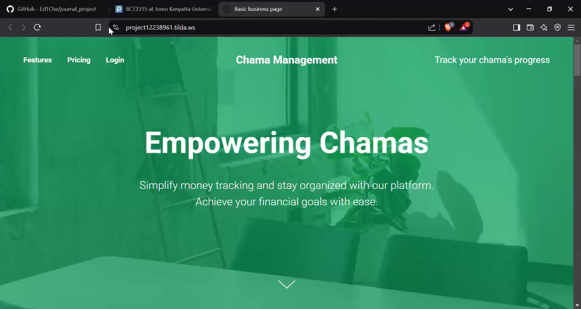
Website Demo

Slide 12
THANK YOU

Slide 13
























RESOURCE PAGE

